Slide 1
Capturing Remote Data in WIMS with

Slide 2
What is doFORMS™?
IIM has partnered with doFORMS™, a third party vendor that allows data entry forms to be created on a website and dispatched to Android and iOS devices allowing data to be collected from anywhere at anytime and automatically imported into WIMS eliminating any need for paper exchange.

Slide 3
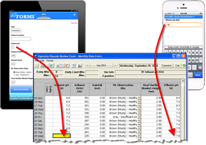
How Does It Work?
Log in to doFORMS™ (www.doforms.com) to easily create forms that mimic routes for data collection
Download and run doFORMS™ app on Android or iOS device to access forms (forms are automatically pushed to devices when connected to WIFI or cellular connection)
Collect/record data in available forms on device
Data is stored in doFORMS™ database (cloud) where an interface pushes data to WIMS
Demonstration

Slide 4
Example of Data Entry on an iPad

Slide 5
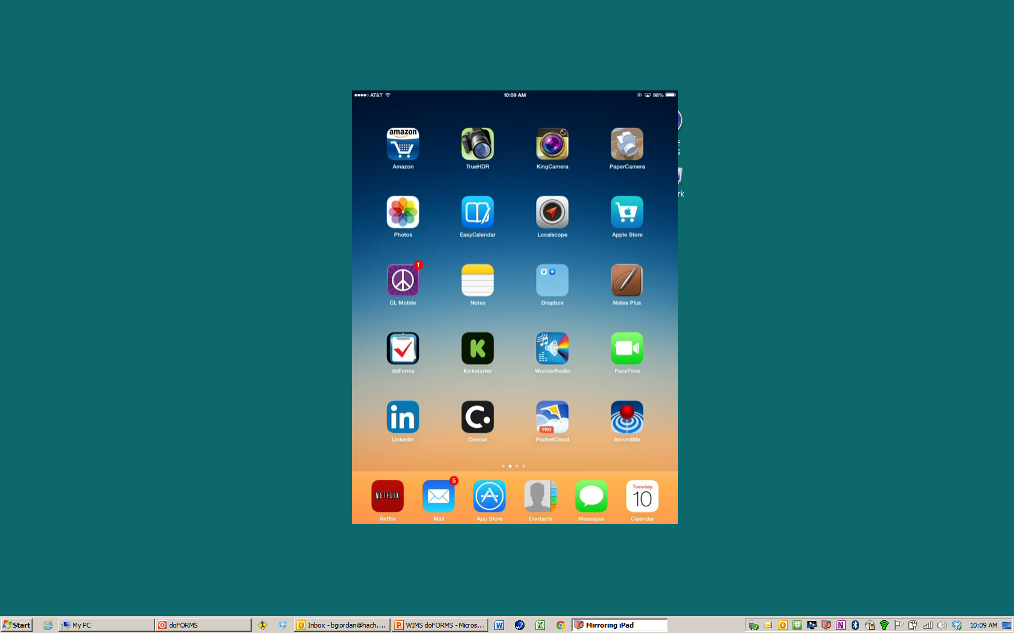
Select the do Forms app

Slide 6
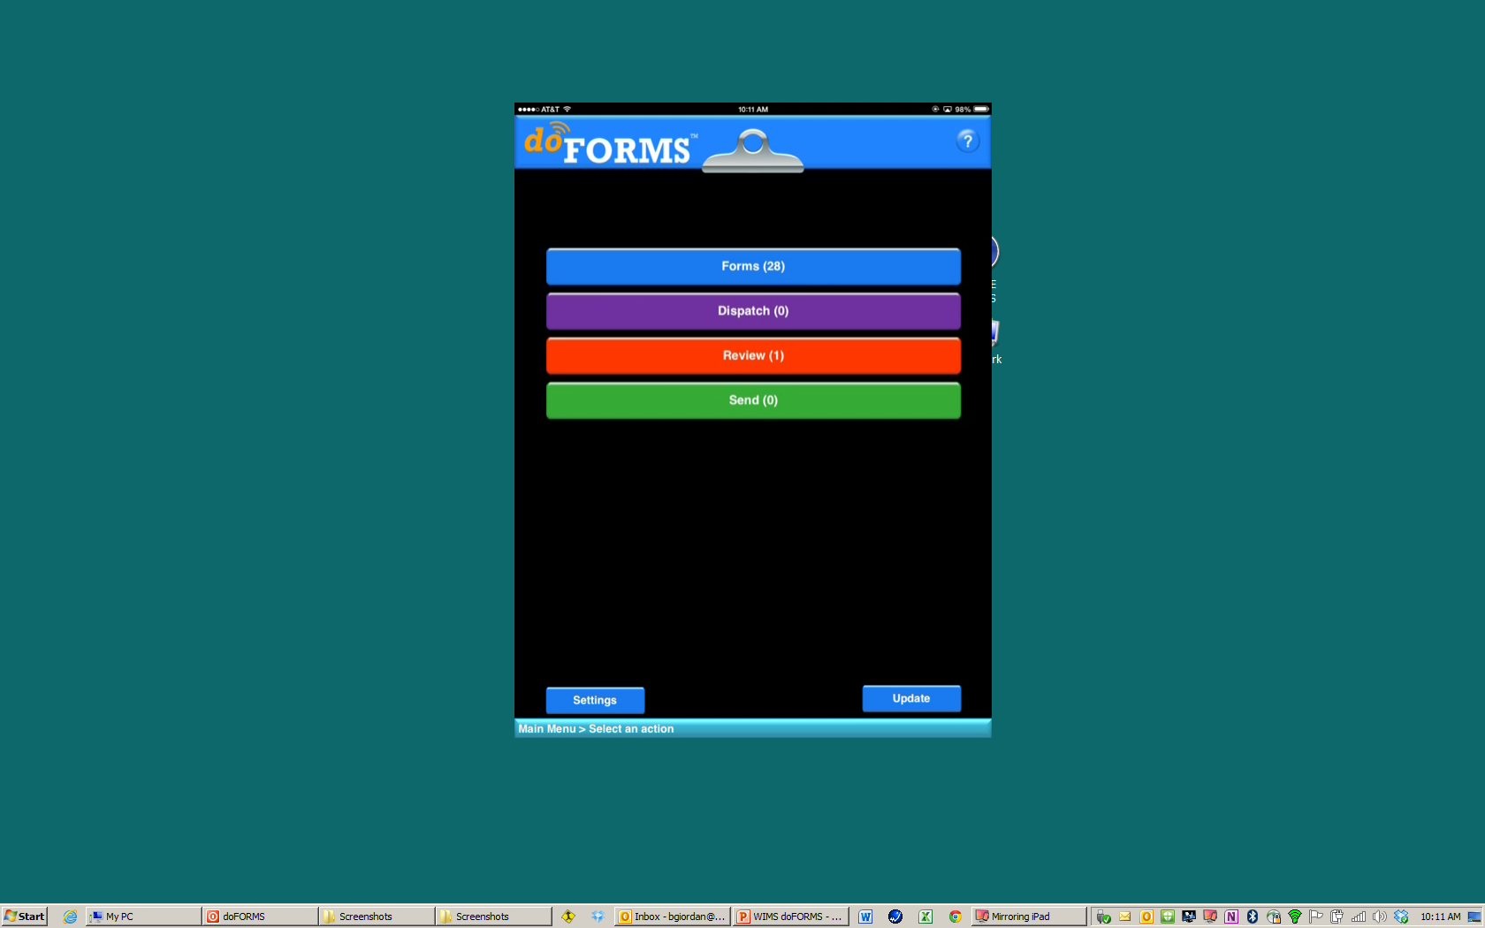
Select form

Slide 7
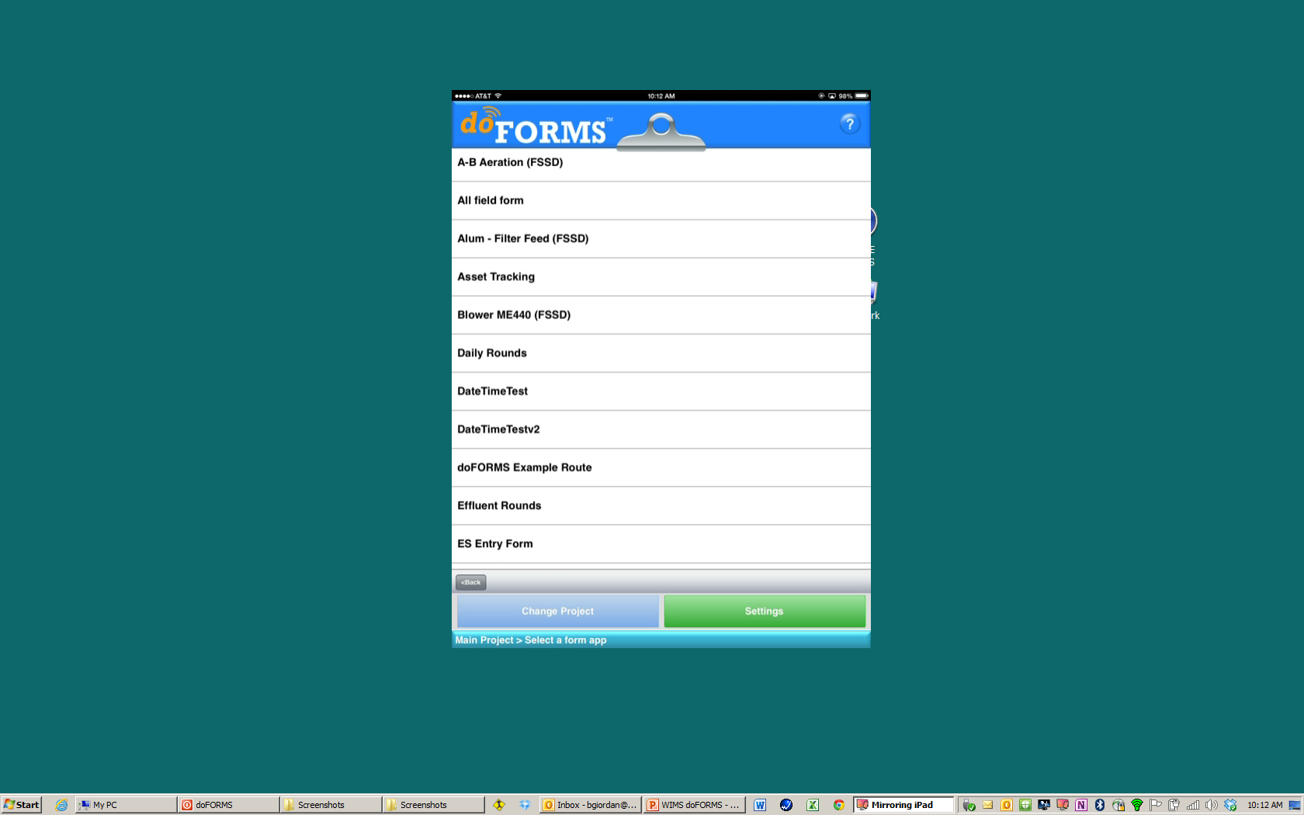
Choose form

Slide 8
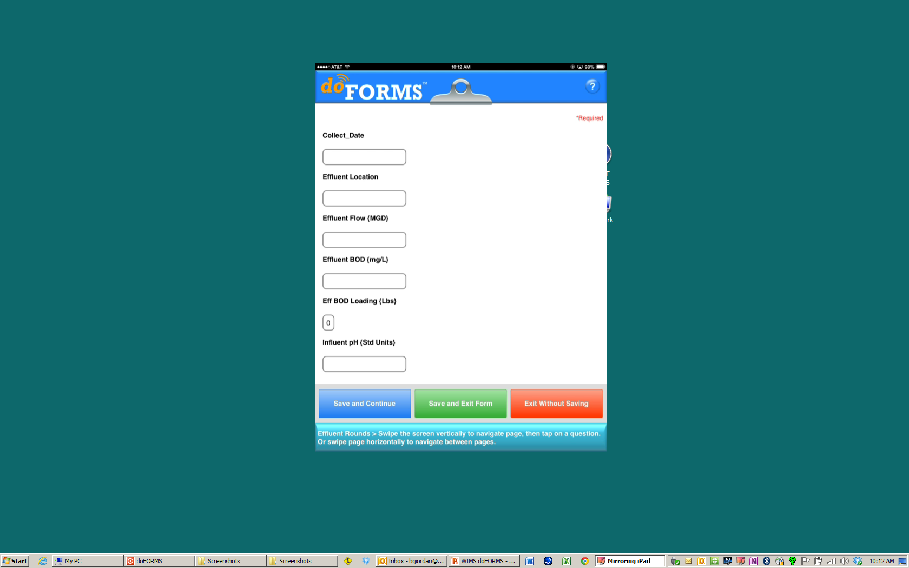
Fill in data fields

Slide 9
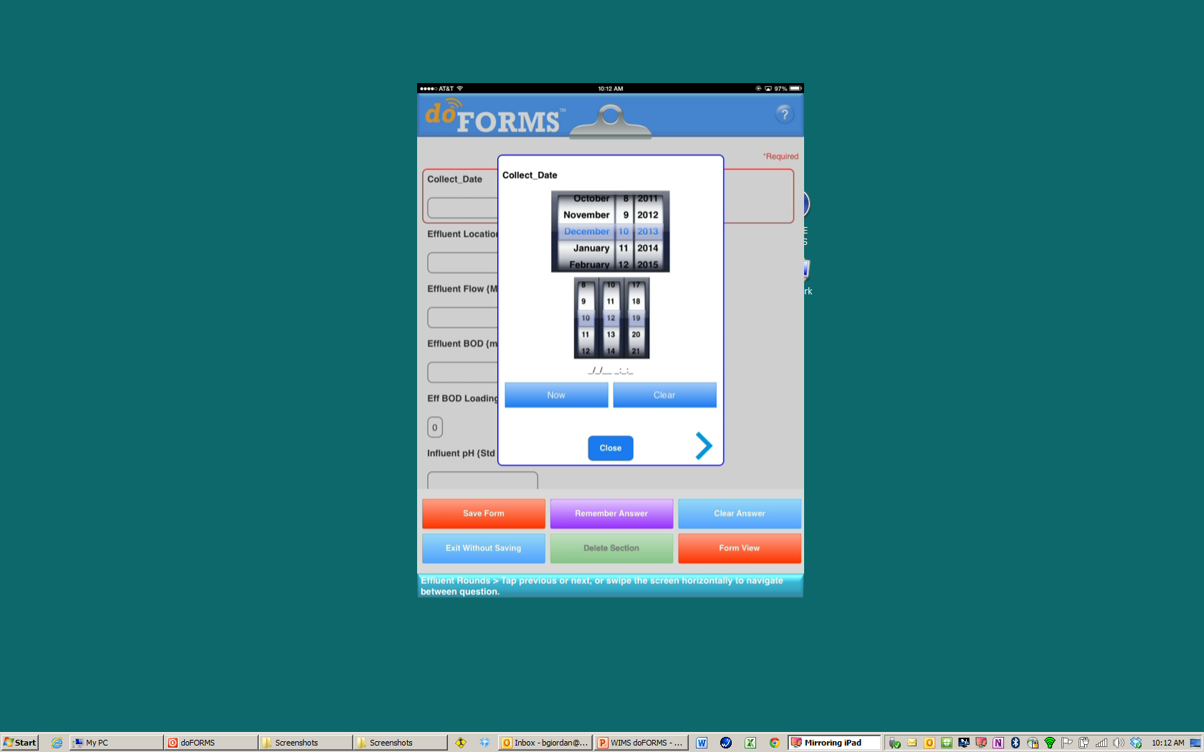
Date selector appears
Choose date

Slide 10
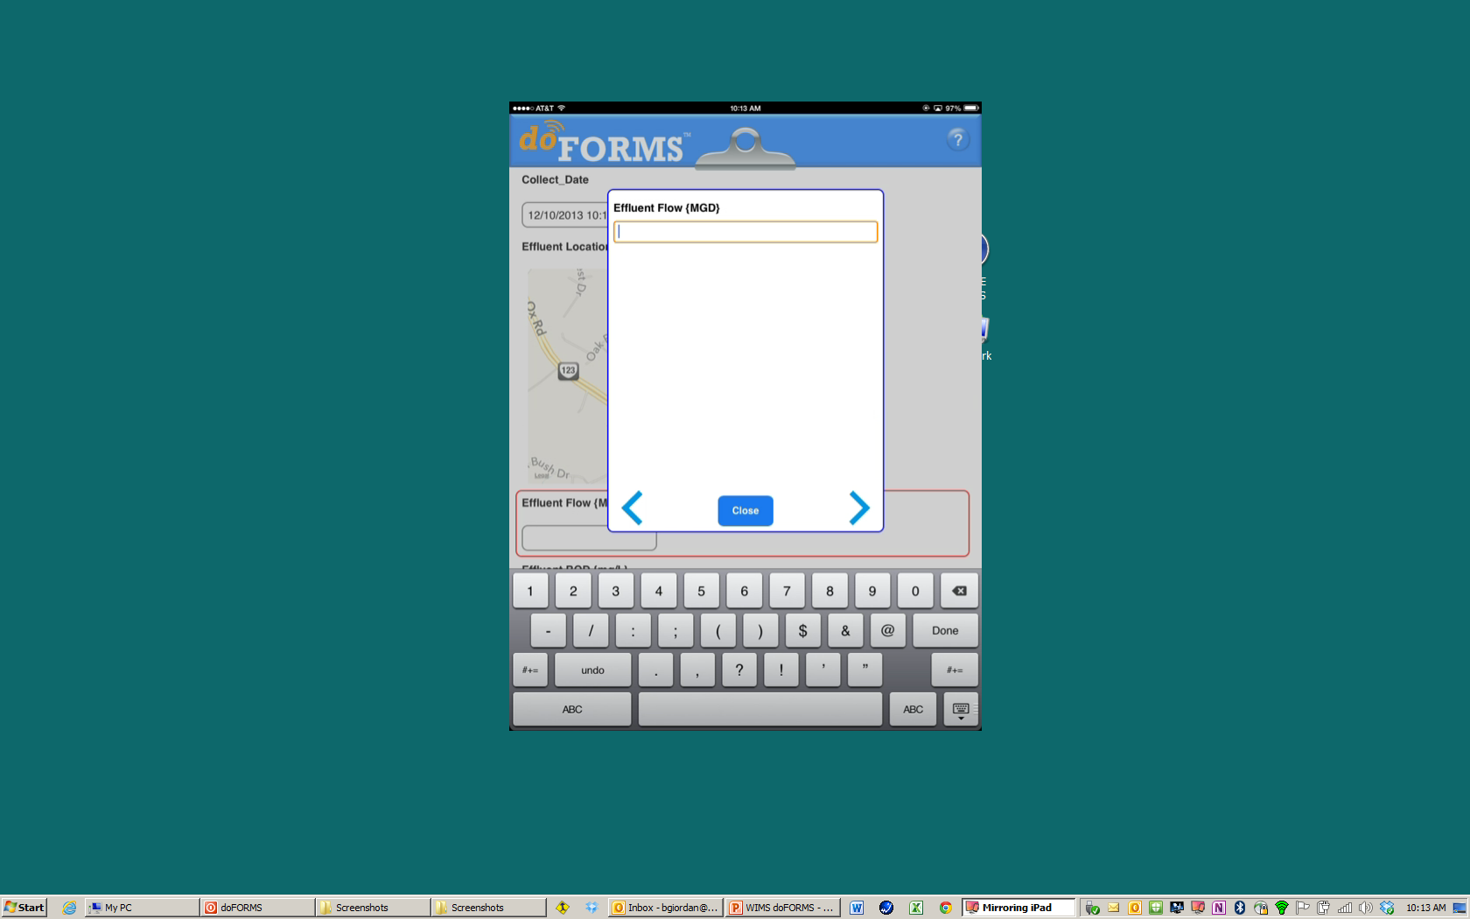
Enter requested data

Slide 11
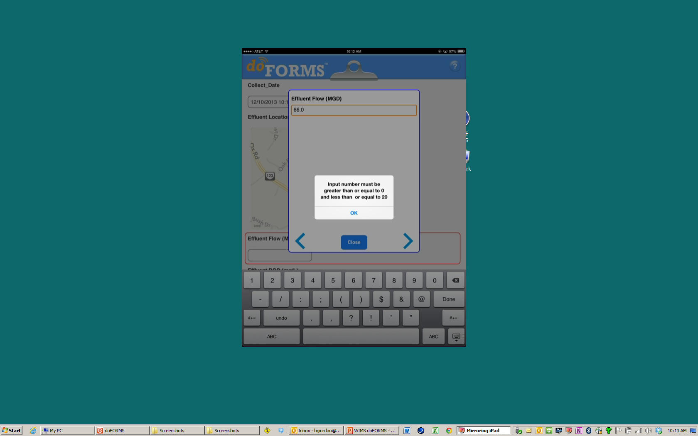
Auto limit checking

Slide 12
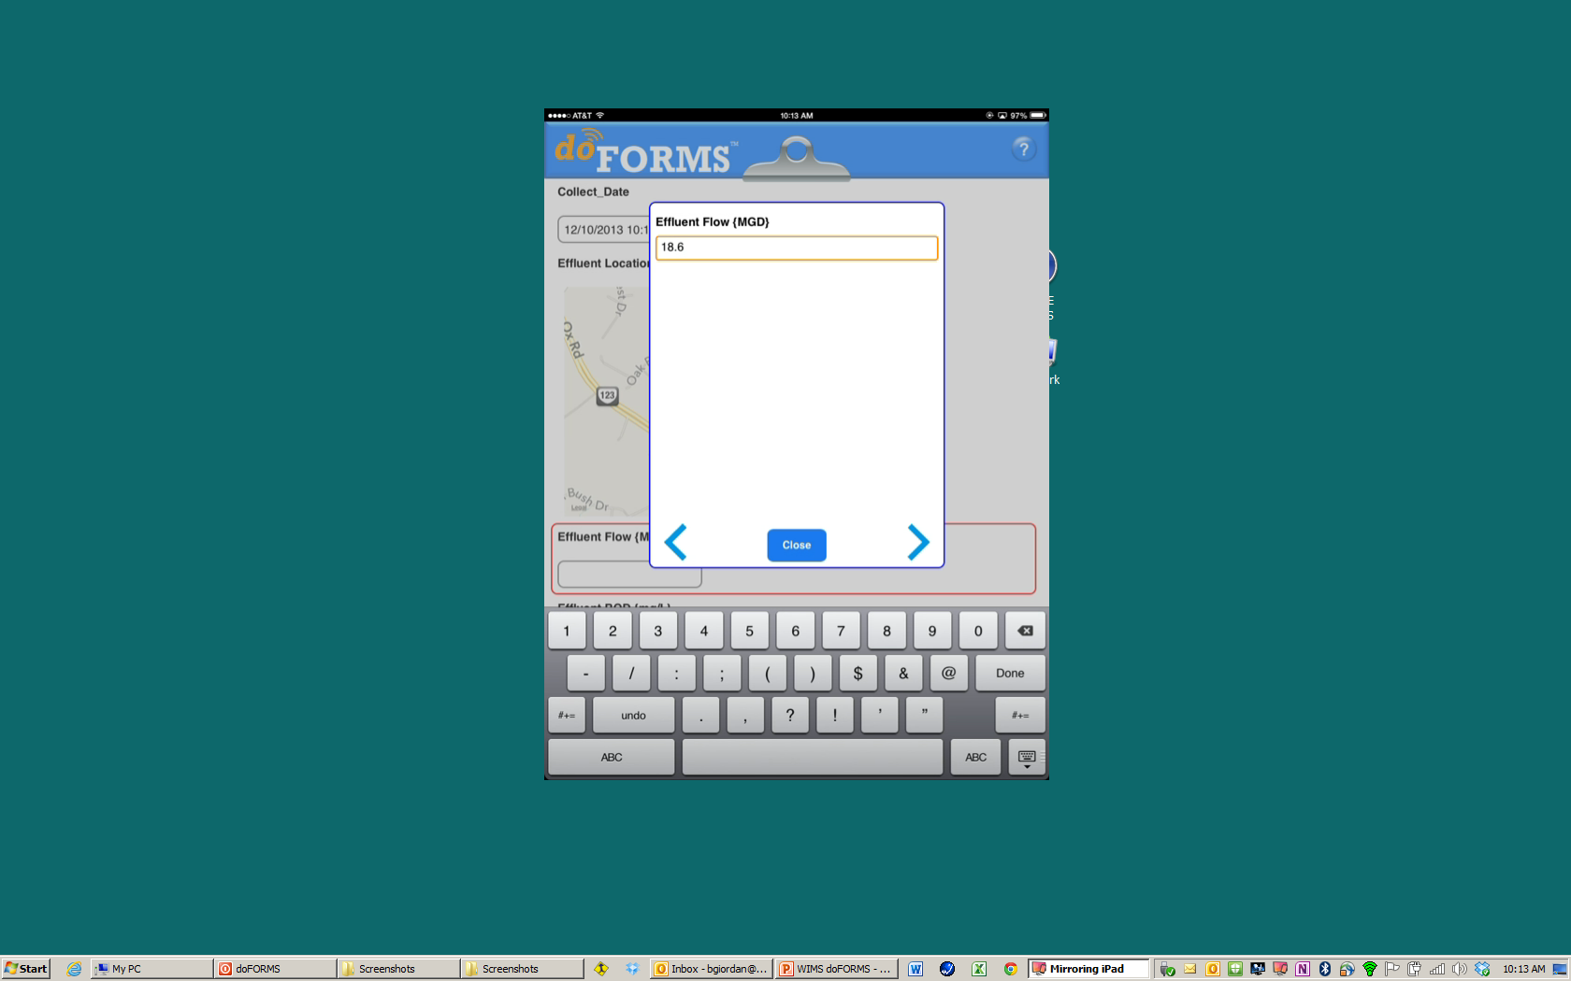
Enter valid data
touch right arrow

Slide 13
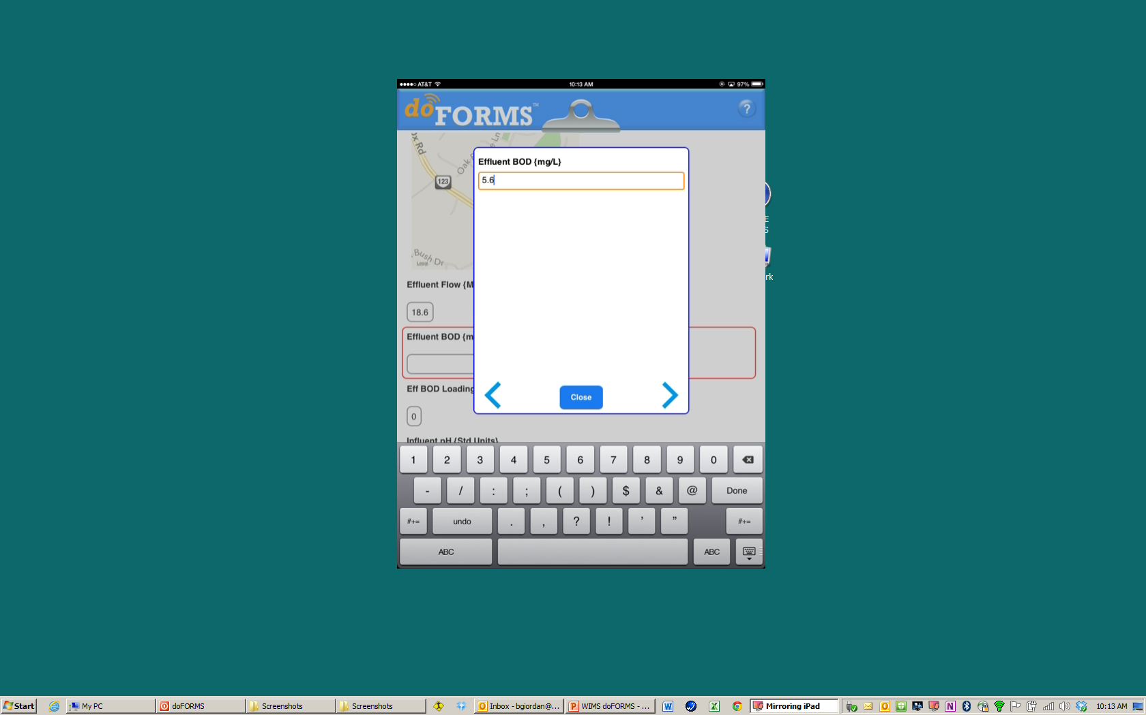
Enter valid data
touch right arrow

Slide 14
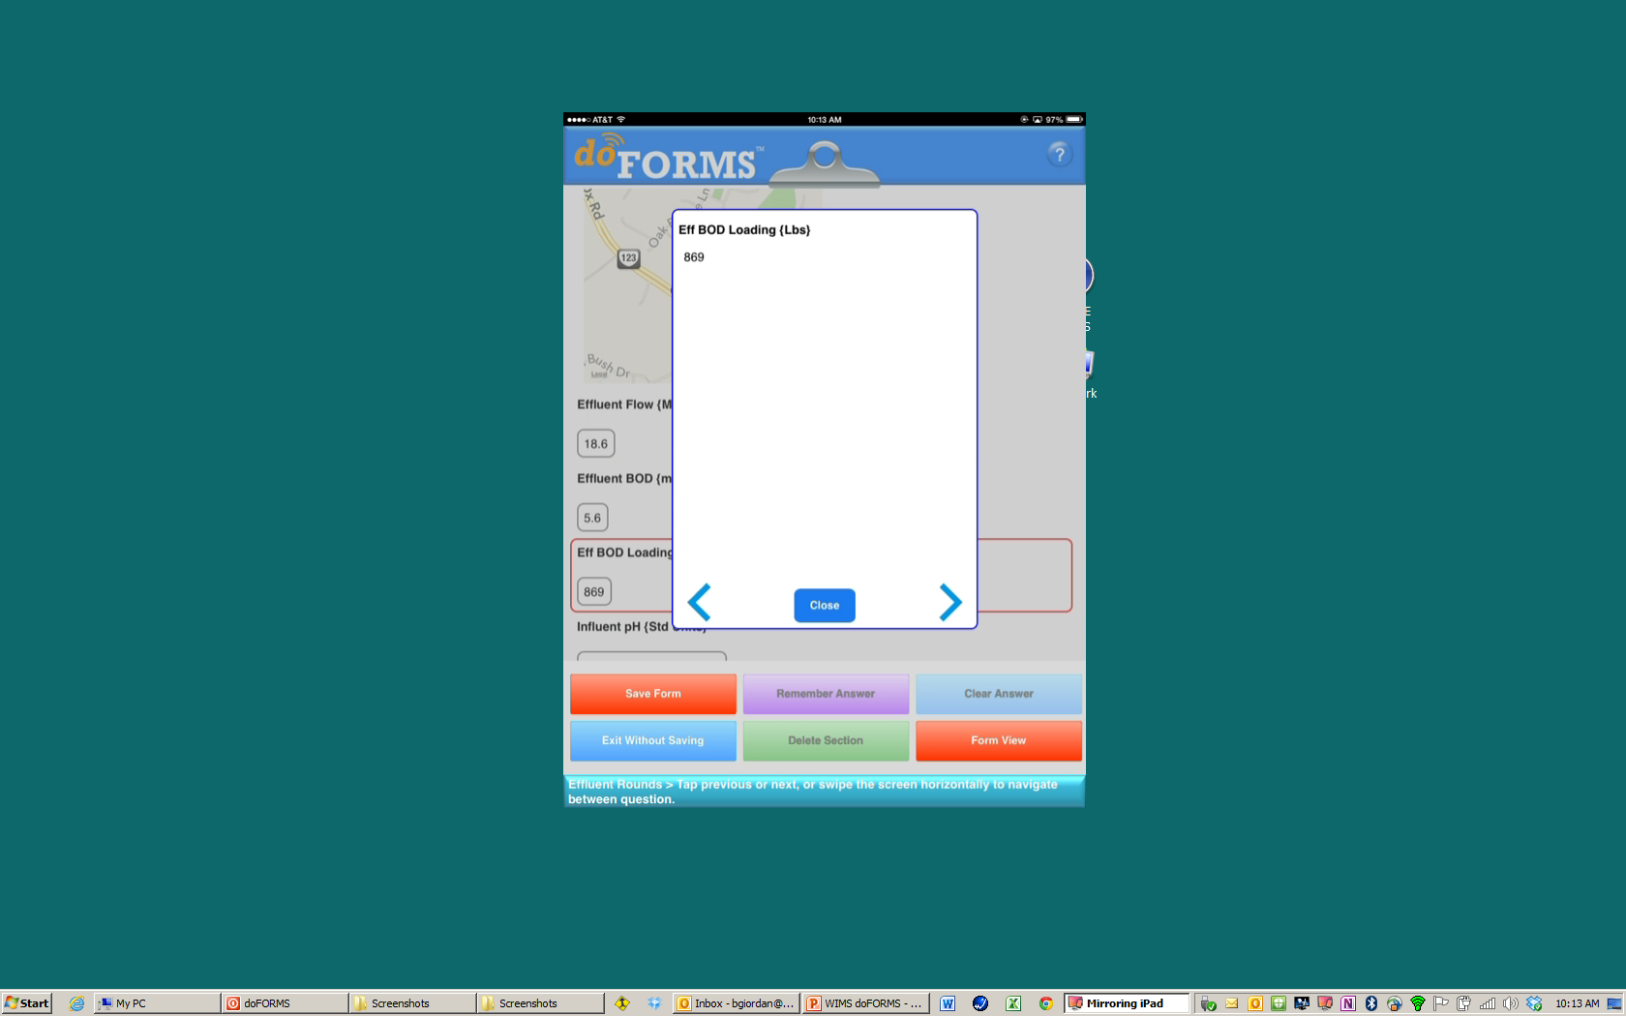
Auto calculations
within the form

Slide 15
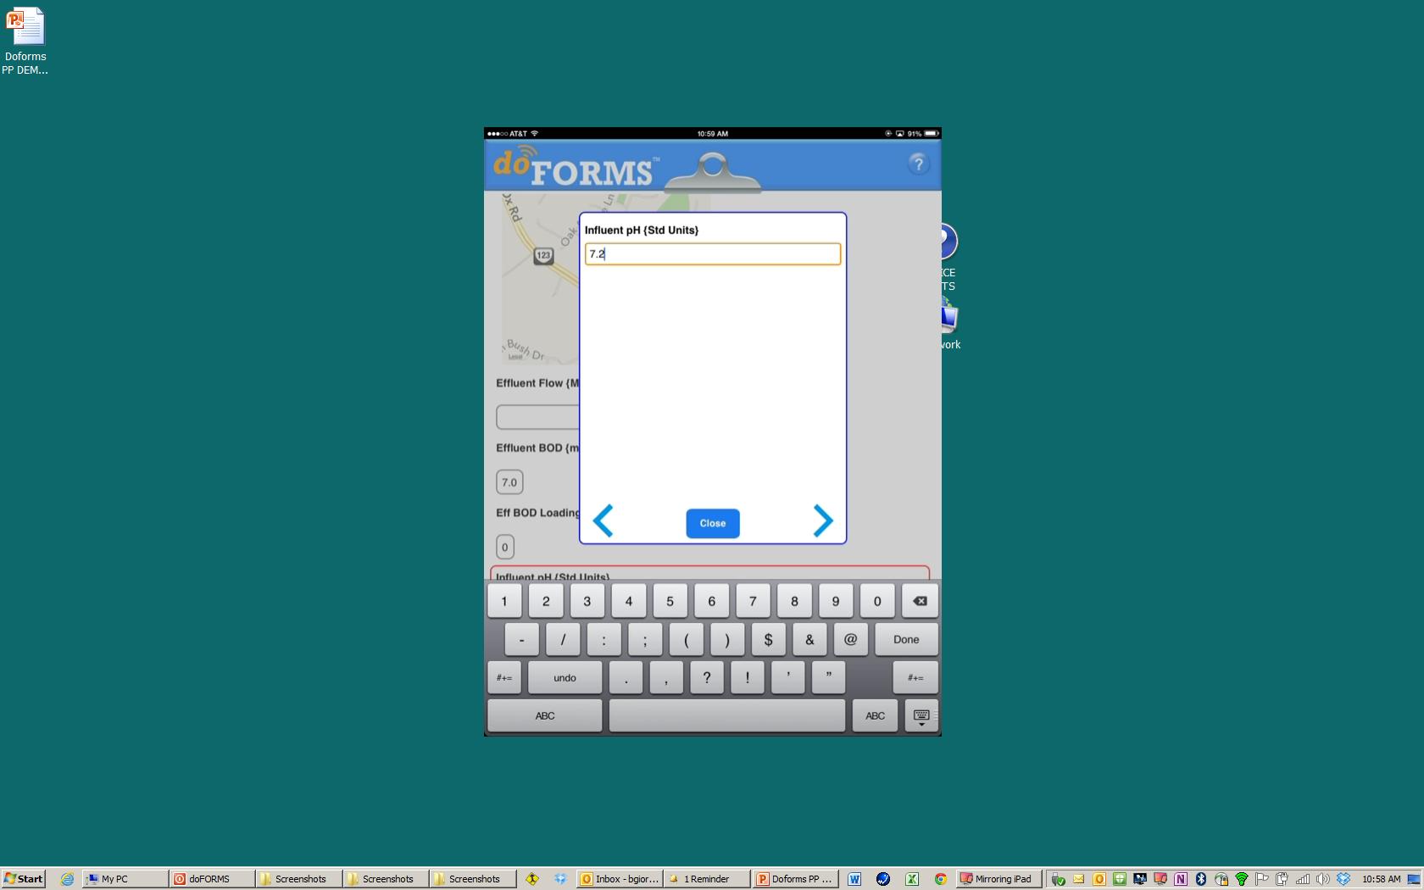
Enter valid data
touch right arrow

Slide 16
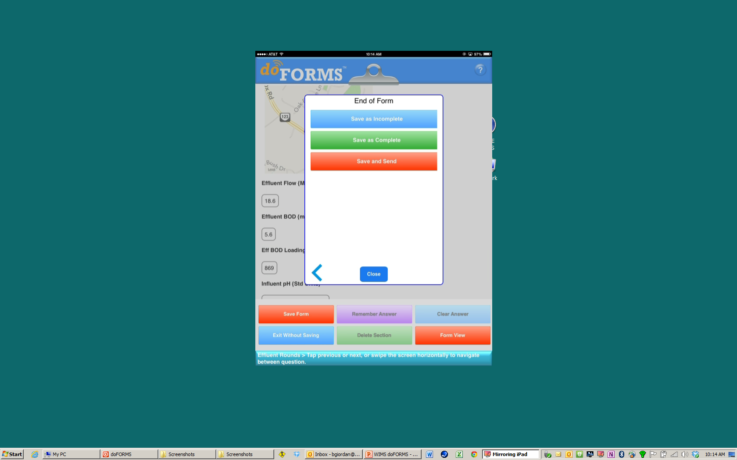
Click Save and Send

Slide 17
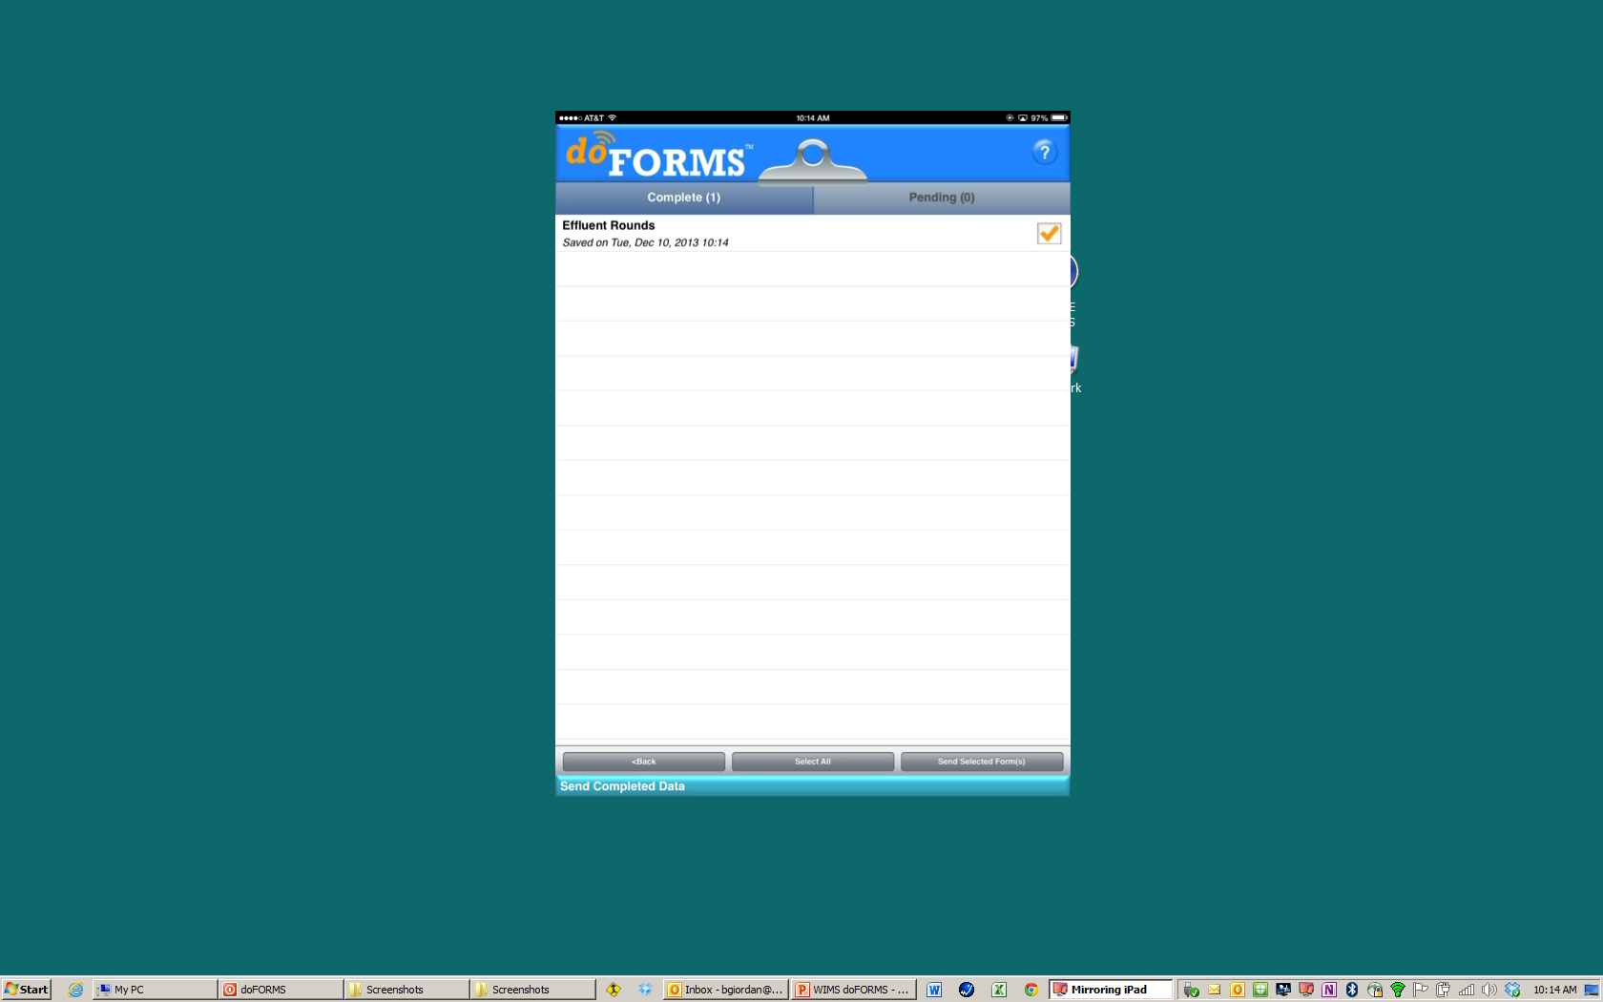
Review data,
Upload to doFORMS for transfer into WIMS

Slide 18
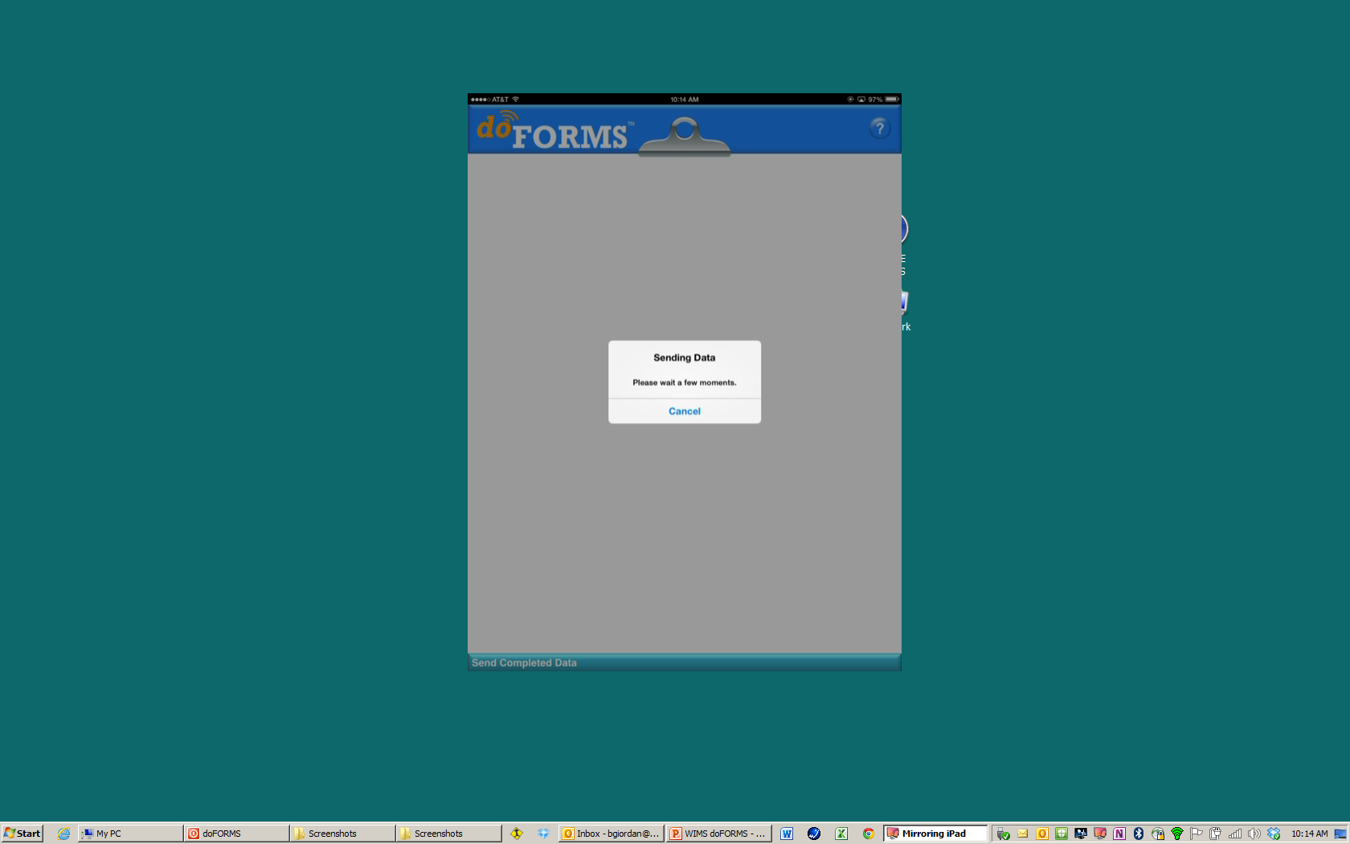
Status of upload

Slide 19
Features and Benefits
Use your existing smartphones and tablets to collect data in the field
Store and forward – You do not need to be connected to the internet to collect data
Once connected, your data is automatically imported to WIMS
Range checking in the field allows quick problem identification and provides accurate data
No more paper forms and no “interpreting” handwritten notes and numbers
Data is updated regularly and available in WIMS immediately after connecting
With doFORMS™, your data is securely stored in geo-redundant Google datacenters with SSAE 16/ISAE 3402 Type II certifications until it is securely moved to WIMS
Support services included to help you get started
Support for doForms available through the doForms website

